Slide 1
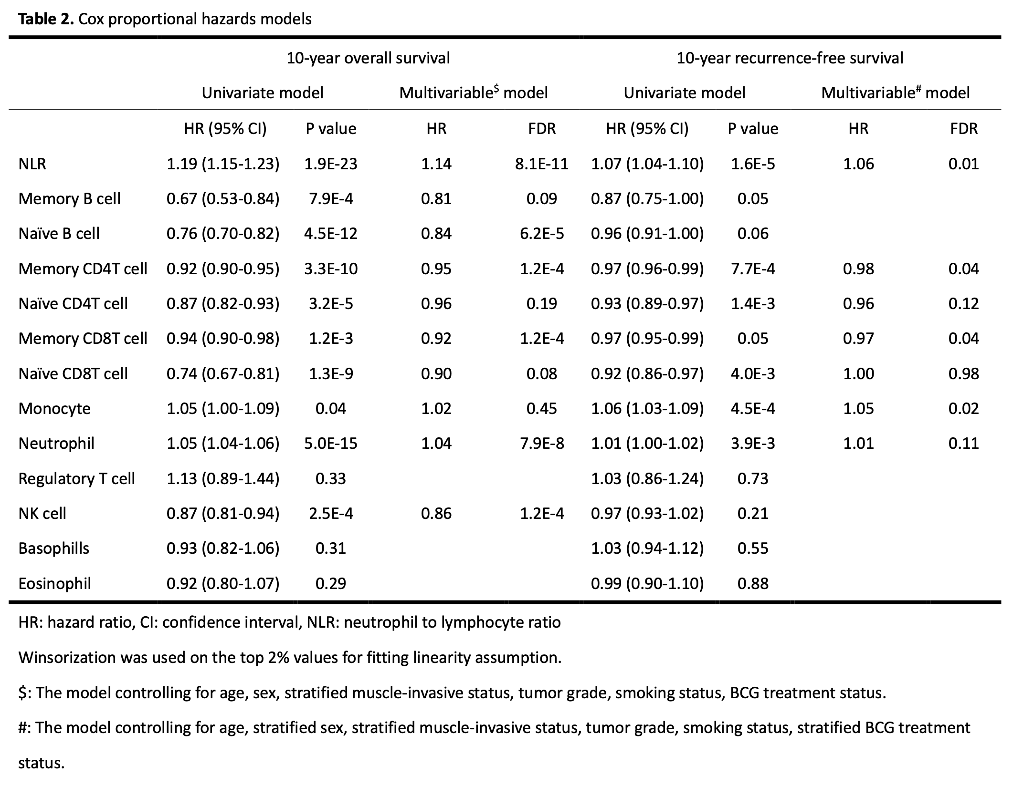

Slide 2
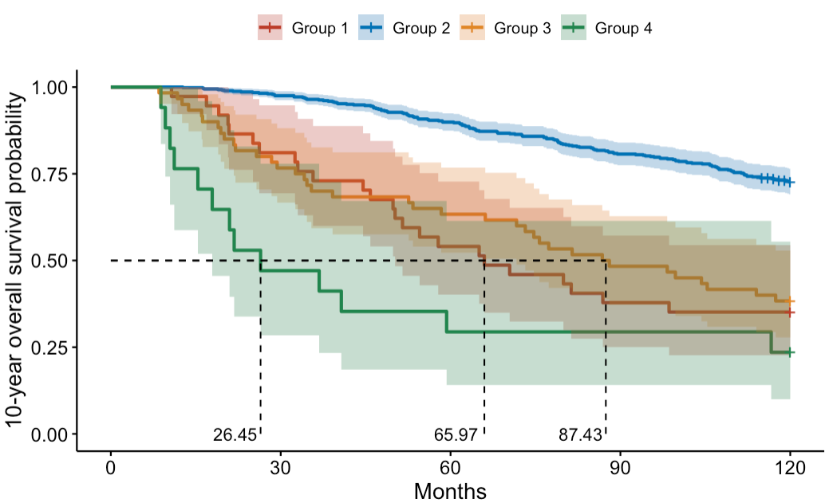
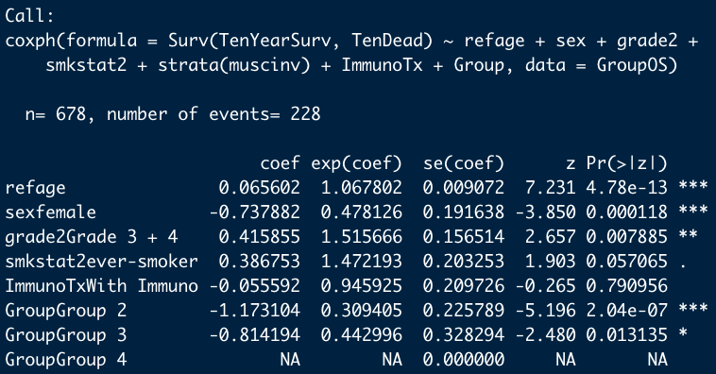
10-year OS
Muscle invasive
P = 1.9E-24
Yes
No
NK
NLR
≤ 1.82
> 1.82
≤ 7.22
> 7.22
Group 4
n = 17
Group 3
n = 60
Group 2
n = 564
Group 1
n = 37
Variables used in survival tree:
Age, Sex, Tumor Grade, Smoking Status, Muscle-invasive status, BCG trt., NLR, Bnv, CD4mem, CD8mem, Neu, NK

Slide 3
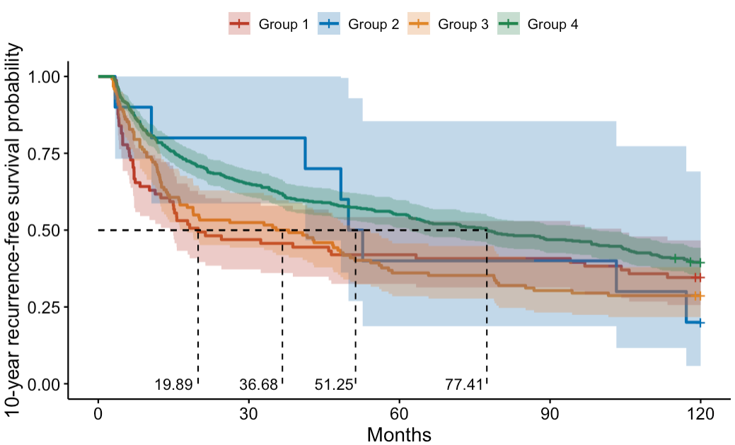
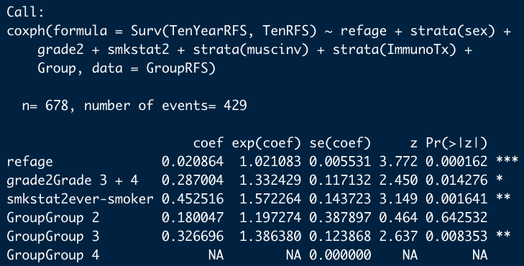
10-year RFS
P = 0.01
BCG
No
Yes
Mono
CD8 mem
≤ 8.86
> 8.86
≤ 0.47
> 0.47
Group 4
n = 465
Group 3
n = 122
Group 2
n = 10
Group 1
n = 81
Variables used in survival tree:
Age, Sex, Tumor Grade, Smoking Status, Muscle-invasive status, BCG trt., NLR, CD4mem, CD8mem, Mono

Slide 4
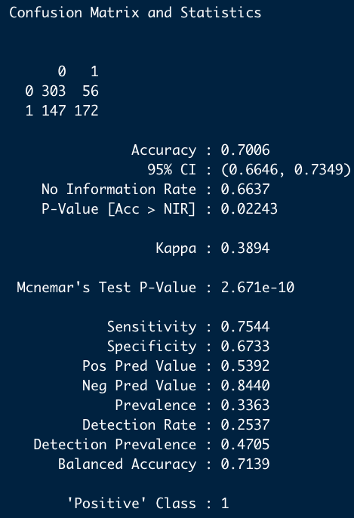
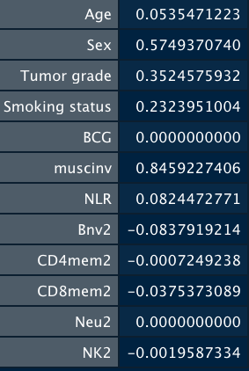
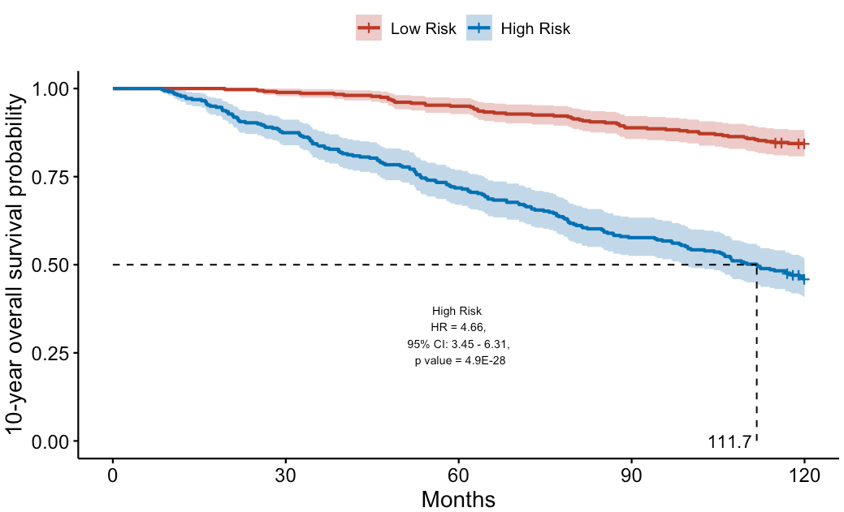
Outcome: 10-year overall survival
Variables: Age, Sex, Tumor Grade, Smoking Status, Muscle-invasive status, BCG trt., NLR, Bnv, CD4mem, CD8mem, Neu, NK
cv.glmnet() were used to find the optimal regularization parameter.
glmnet() were used to train data
Coefficients:
Actual
Predict
Used to calculate bladder cancer OS scores
Optimal.cutpoints() were used to find cutoff point for scores
→ cutoff point: 4.104259

Slide 5
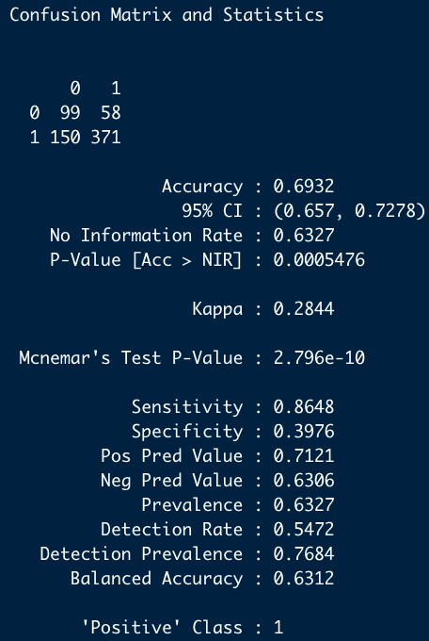
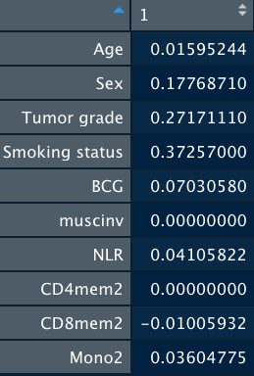
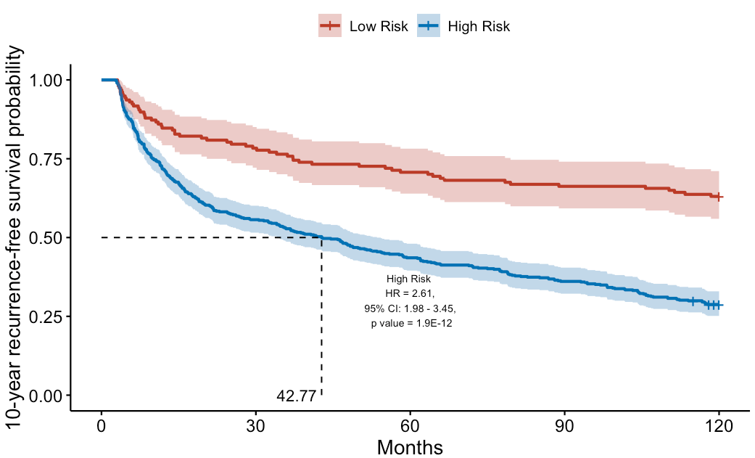
Outcome: 10-year recurrence-free survival
Variables: Age, Sex, Tumor Grade, Smoking Status, Muscle-invasive status, BCG trt., NLR, CD4mem, CD8mem, Mono
cv.glmnet() were used to find the optimal regularization parameter.
glmnet() were used to train data
Coefficients:
Actual
Predict
Used to calculate bladder cancer RFS scores
Optimal.cutpoints() were used to find cutoff point for scores
→ cutoff point: 1.624249

